Slide 1
CCMEP Lifetime Visualization Zaida Jenkins

Slide 2
Comprehensive Case Management & Employment Program
Started in 2016
Combines TANF and WIOA funding
Serves young adults between the ages of 14-24
Helps overcome barriers and achieve self sufficiency
14 distinct services delivered at the county level

Slide 3
Data Source: PIRL
Developed by US Departments of Labor and Education
Framework to support understanding, preparation and submission to DOL
30 Elements Used for Visualization

Slide 4
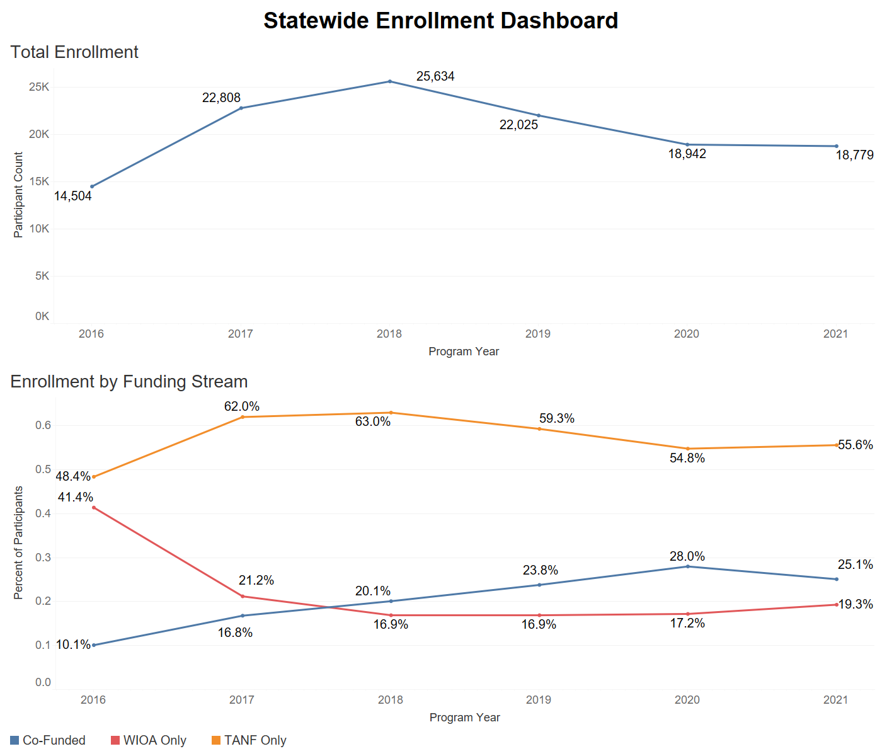
Statewide Enrollment Dashboard
57.25% increase between PY16-17
Gradual increase in co-funded enrollment
COVID-19 Pandemic

Slide 5
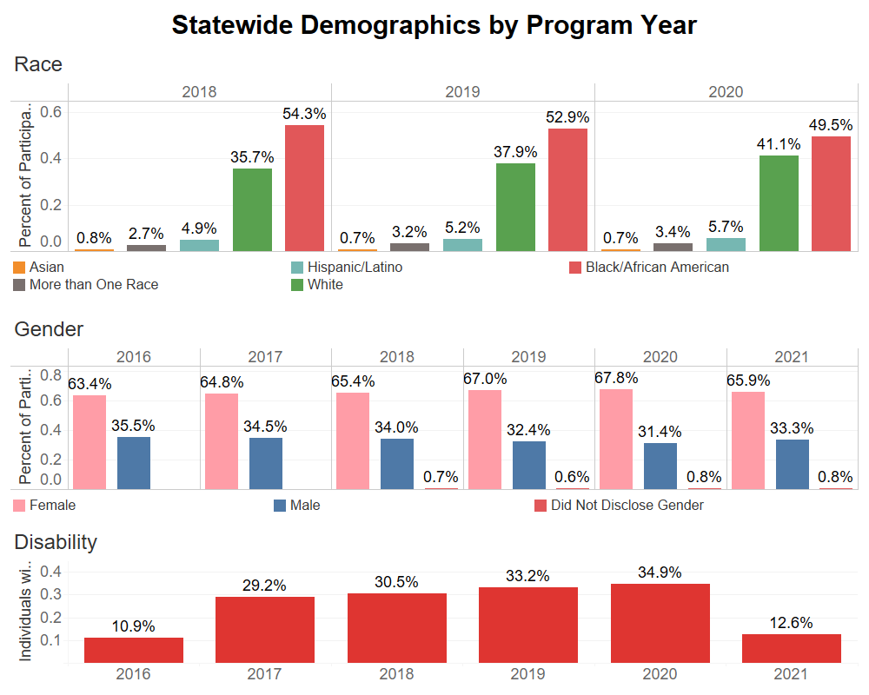
Statewide Demographic Dashboard
Primarily Black/African American and White
Growing Hispanic/Latino Population
Consistent Female dominance
COVID-19 Pandemic

Slide 6
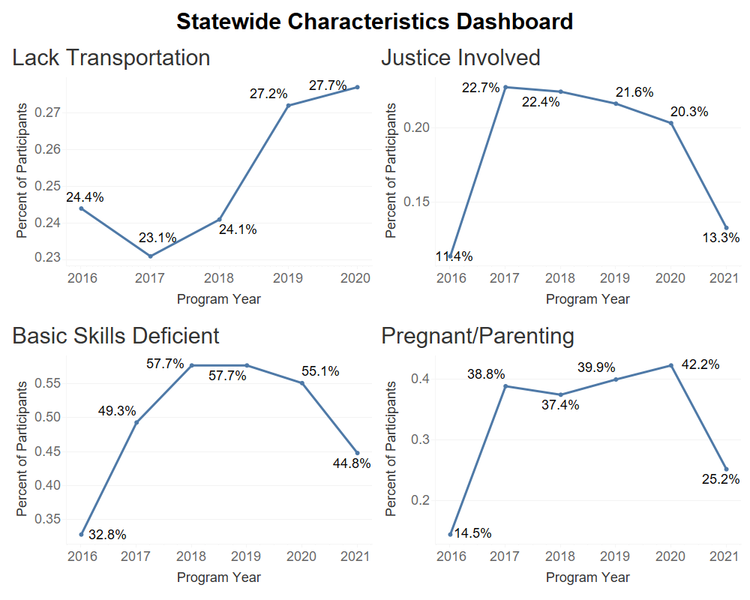
Statewide Characteristics Dashboard
Sharp declines during COVID-19 for justice involved, basic skills deficient and pregnant/parenting participants
Approximately half of all participants perform below a 9th grade level
COVID-19 Pandemic

Slide 7
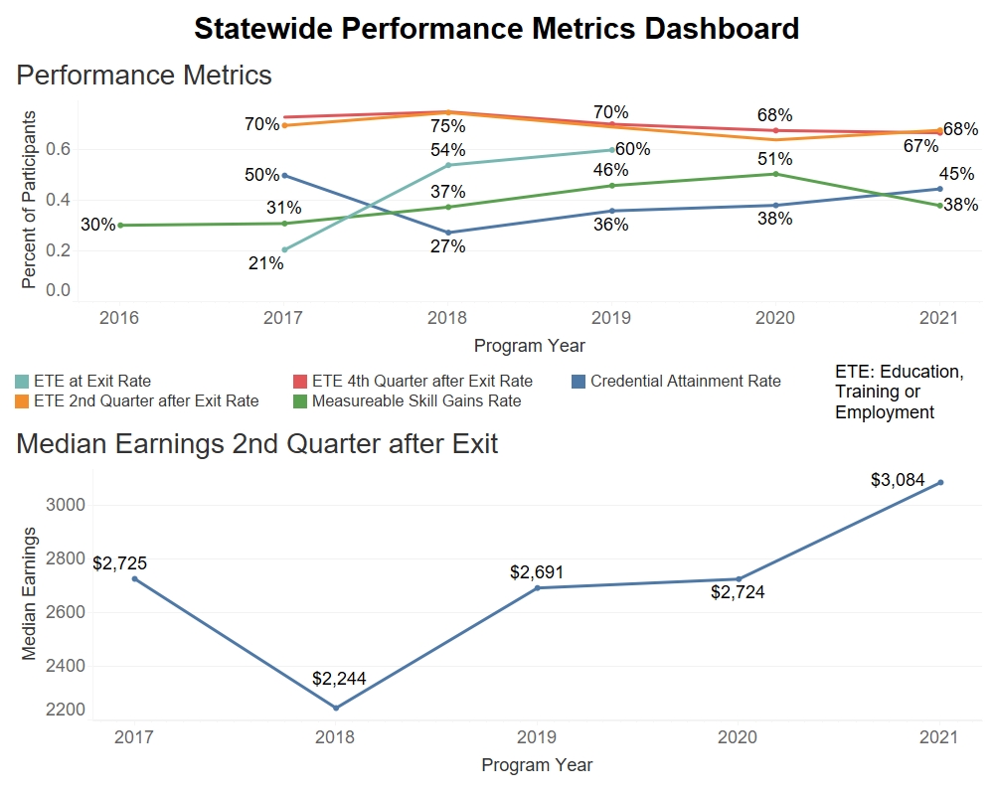
Statewide Performance Dashboard
Average ~70% rates of education, training or employment 2Q and 4Q after exit
13.17% increase in median earnings
COVID-19 Pandemic

Slide 8
Thank You
OERC PSDS Support
Interns
CCMEP Team
Gerrie Cotter
Theresa Groth-Joynt
Angie Lancaster
Abbi DeLisio
Catherine Rafferty
Tiffany Day
Yvonne McDaniel
Chris Evans
Cordelia Van der Veer
Elizabeth Yirava
Alyssa Gebby
Josh Hawley
Evelyn Arrey
Ceanna Burnheimer
Seong Ji Jeong

Slide 9
Questions?

